Slide 1
Tensor Test
Live Application Testing with Deep Neural Network Classifications

Slide 2

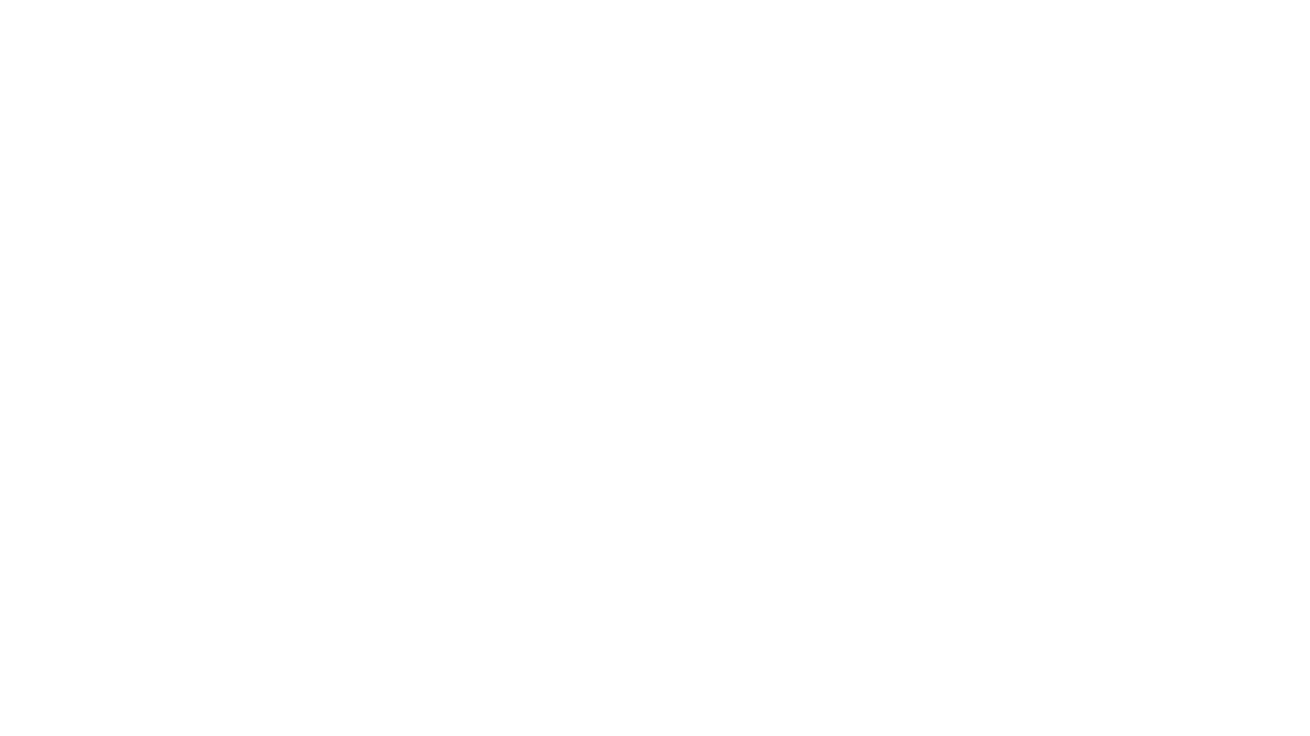
Overview
Collect input to a web API along with application status code responses
Use machine learning to train against this data
Build predictions for future status codes based on past responses
Provide ability to flag deviations from past results as potential regressions

Slide 3
What’s In the Box?
Tensor Test Web Service
Python Flask Web API
TensorFlow machine learning libraries
MongoDB persistence layer
Java Client
Enables application to send training and test requests
Tensor Test Portal
Allows manual demo or one-off testing

Slide 4
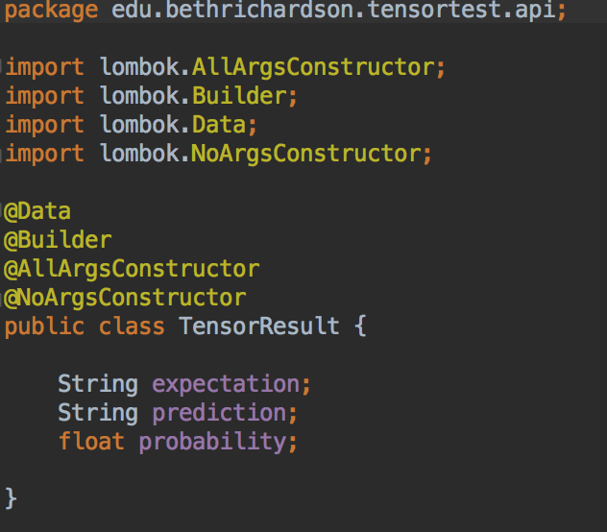
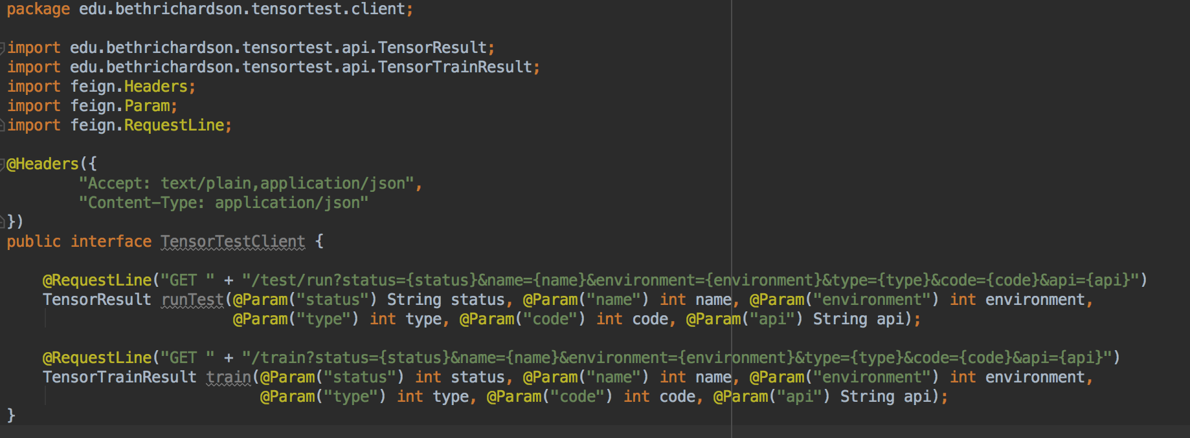
Tensor Flow Java Client

Slide 5
TensorFlow Terms
A feature is an input variable, the x variable in simple linear regression. (API input parameter)
A label is the outcome that is predicted by the machine learning model for a given set of features. (status code)
A fully-connected neural network is a model that is composed of layers of connected neurons, in which each layer takes inputs from every neuron in the previous layer (tf.estimator.DNNClassifier)

Slide 6
Tensor Test Classifications
Three distinct output classifications for the given input based on the HTTP status code returned for the request: 200, 400 range, and 500 range.

Slide 7
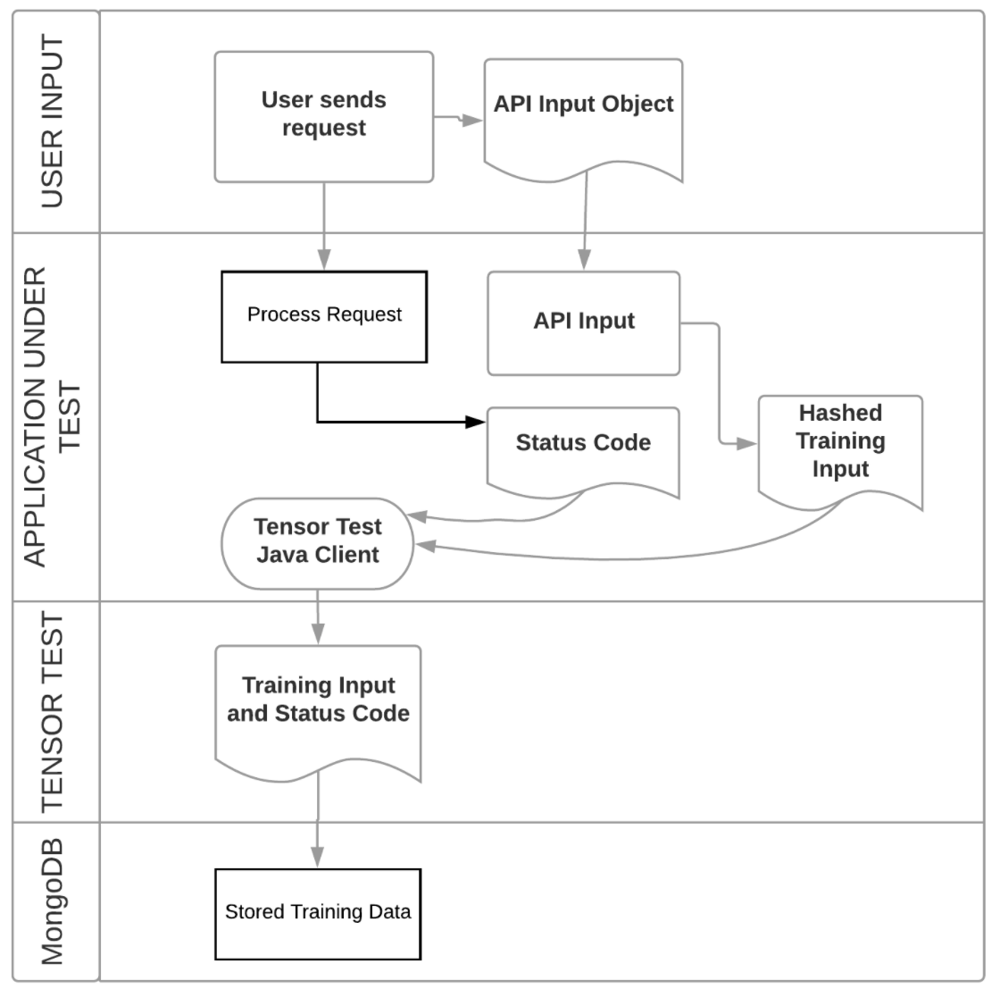
Training The Model
During a live application request
Hashes input and sends to Tensor Test
Stores Training data in MongoDB

Slide 8
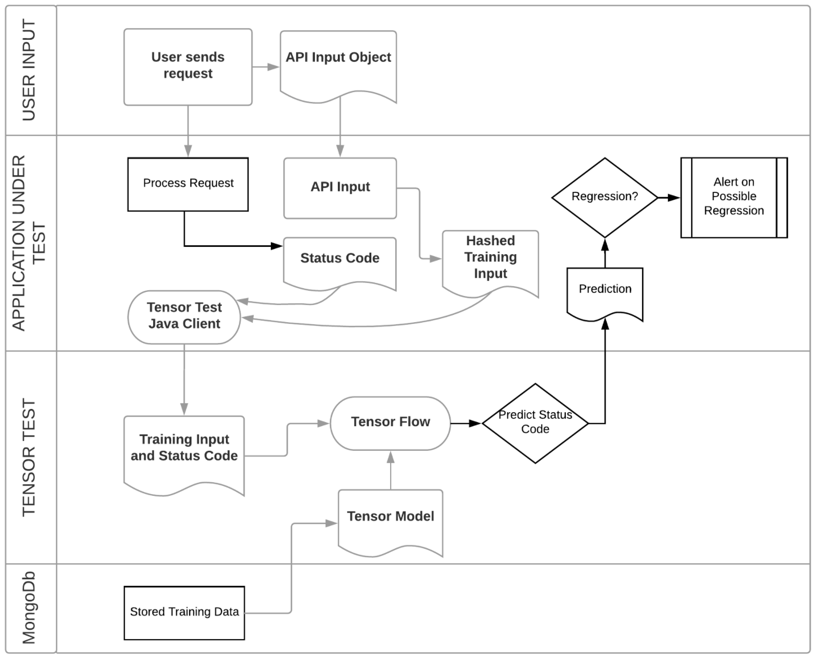
Testing A Request
During a live application request
Hashes input and sends to Tensor Test
Loads Training data in a DataFrame
Builds Classifier and runs prediction
Returns expected, prediction, probability
Application can alert appropriately

Slide 9
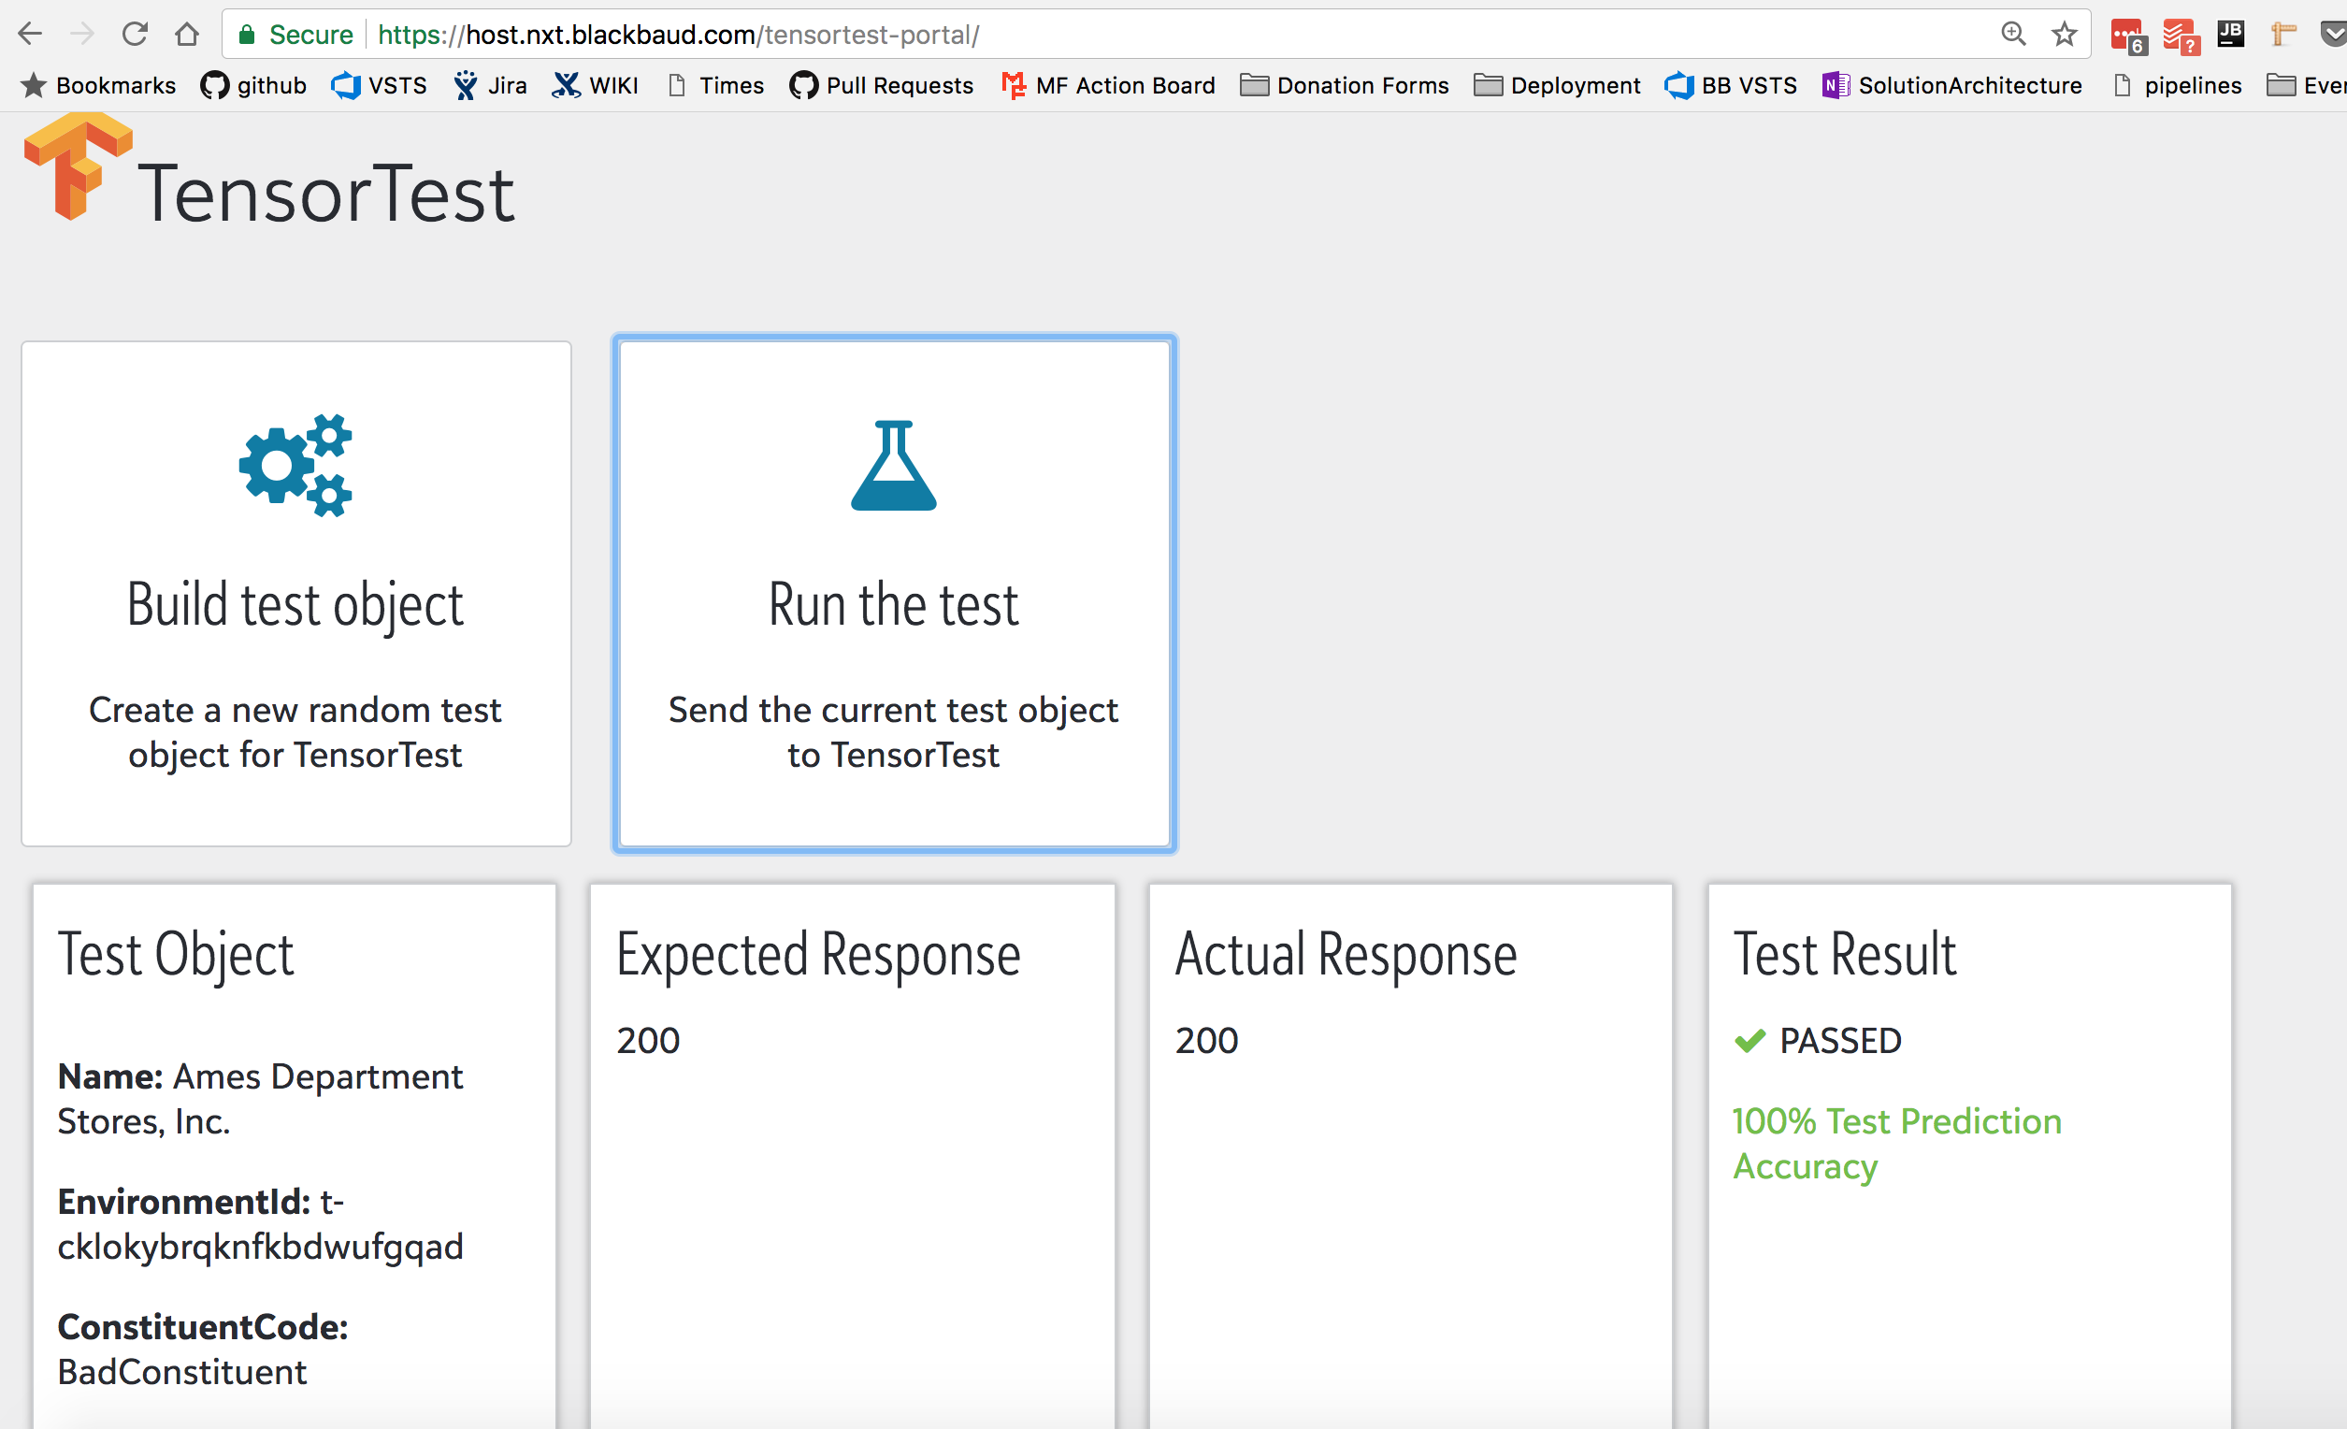
Tensor Test Portal (Demo Time)
Creates random inputs using a data builder pattern and Chance
Sends requests to live application and to Tensor Test and compares results
Displays test result and probability/confidence for this result

Slide 10
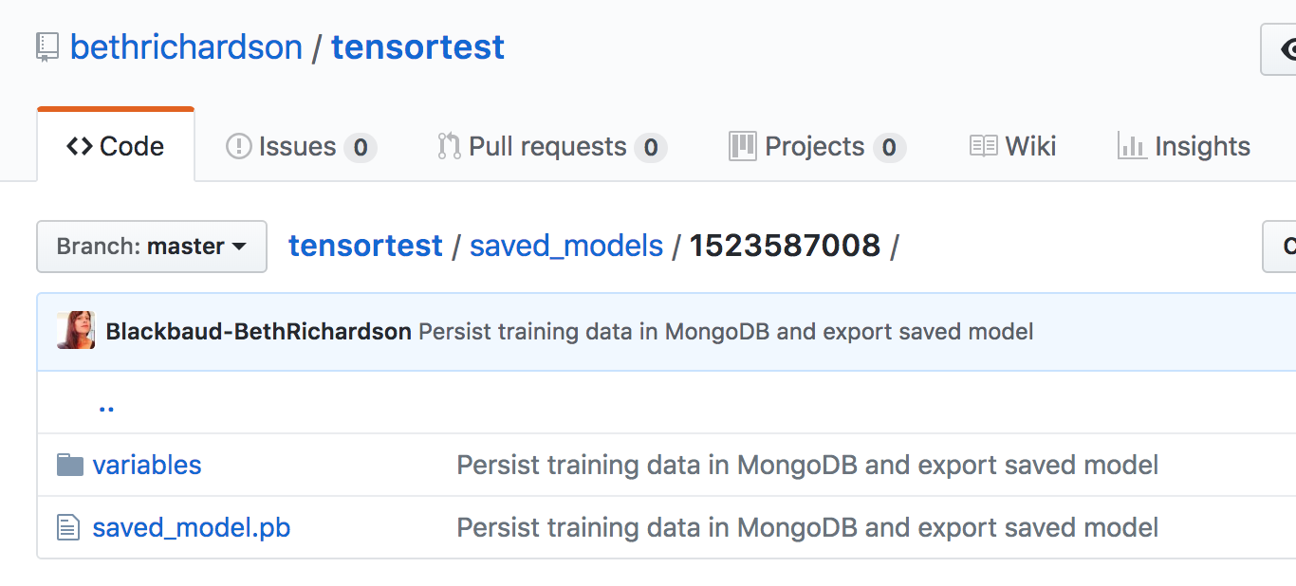
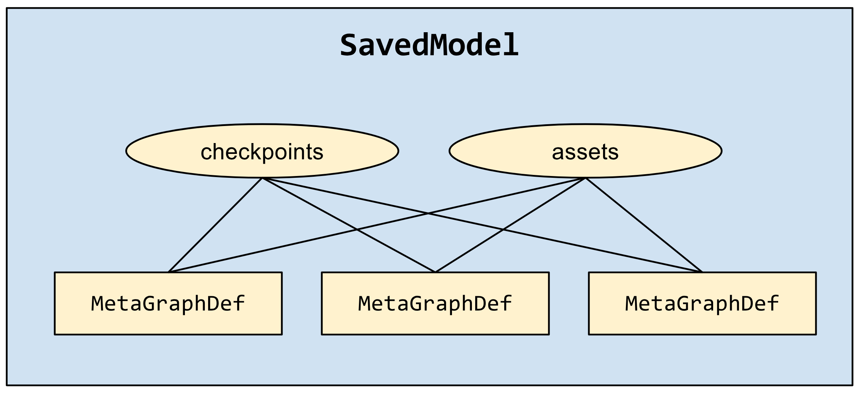
Future Improvements
Saved Models
Allowing various input collections/APIs
Alerting on response time degradation
Hashing/Encryption built in

Slide 11
“People worry that computers will get too smart and take over the world, but the real problem is that they're too stupid and they've already taken over the world.”
- Pedro Domingos
Any Questions?

